Slide 1

Course Code: MATH 211
Course Title: MATH III
Lecture 6 (Inverse Laplace Transform)
Tazin Tamanna
Lecturer in Mathematics
Department of Science and Humanities
M.Sc. in Applied Mathematics (KU)
B.Sc. in Mathematics (KU)

Slide 6
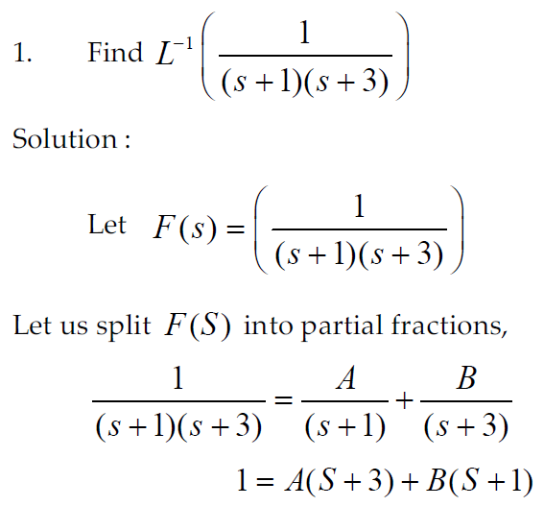

Slide 7
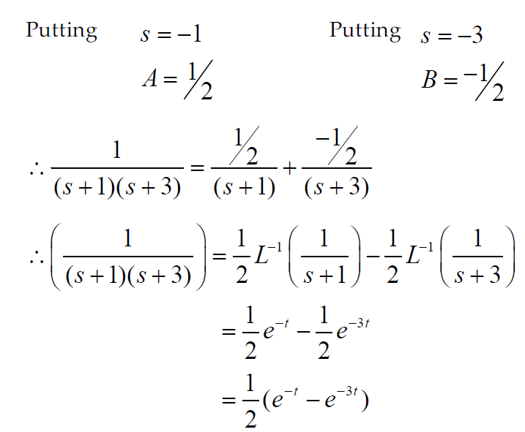

Slide 8
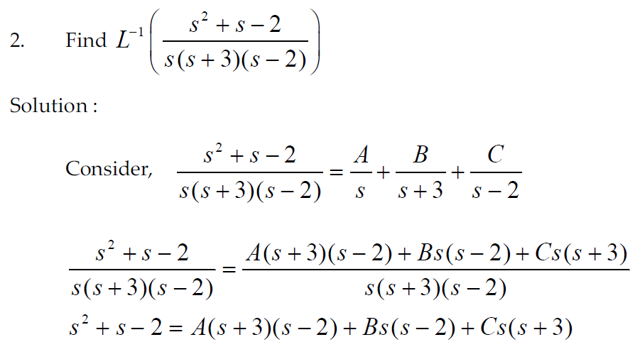

Slide 9
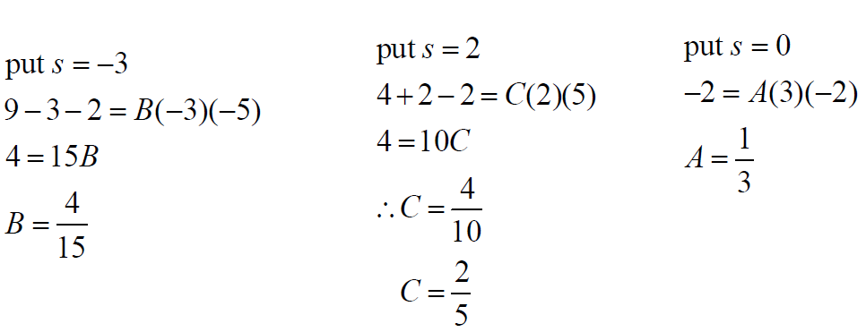
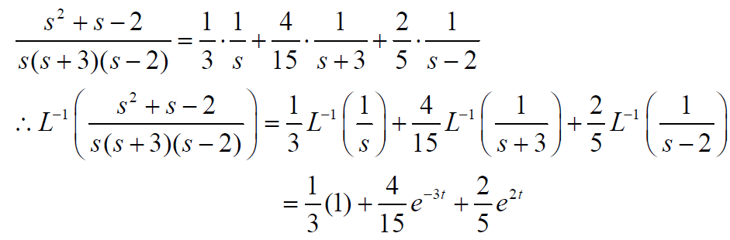

Slide 10
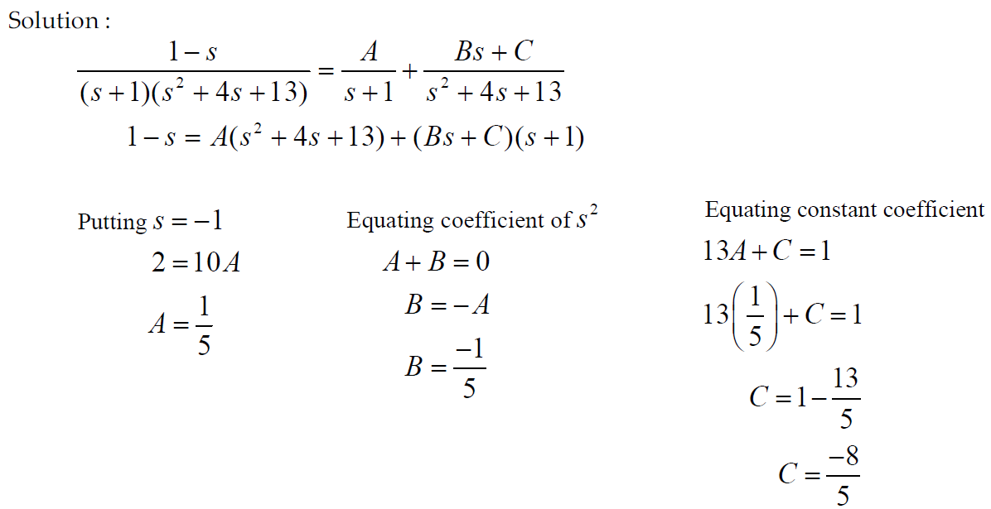
3.

Slide 11
